Slide 1
For Live Session Assignment (FLS)
Unit 6

Slide 2
Question 1: Quick Quiz Questions

Slide 3
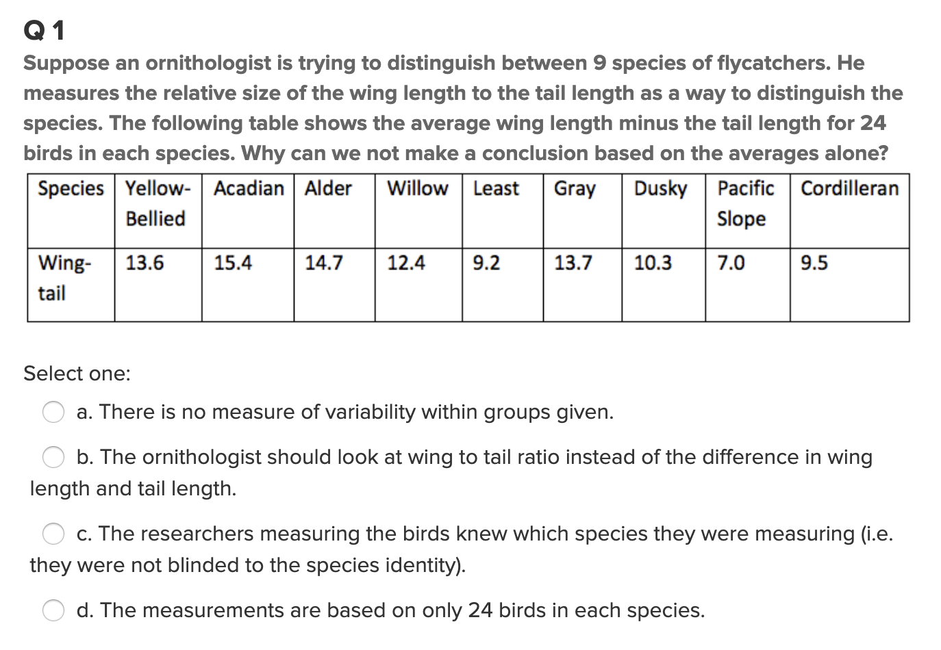
Question 1 (<10 min)

Slide 4
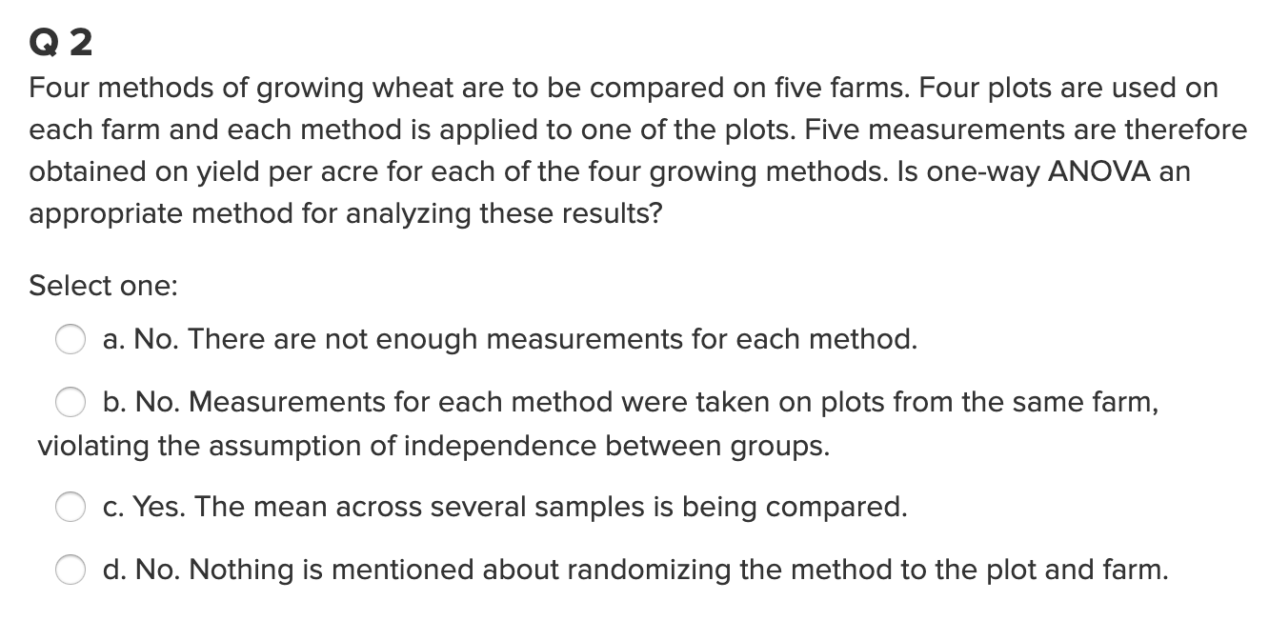
Question 2 (< 10 min)

Slide 5
End Question 1: Quick Quiz Questions

Slide 6

Question 2 ($≤2$ hours)

Slide 7
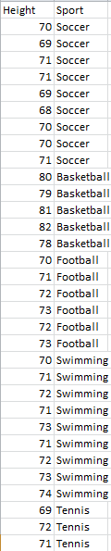

Height!
5 different sports were analyzed to see if the average height of basketball players was greater than the average of all the other sports. We could, of course, compare each pairwise grouping of sports, but that would result in 4 tests. This would take a lot of time, and those tests would each have less power since they don’t use all the data (think about this point, we will discuss is Live Session.) Let’s use ANOVA similarly to how we did in prior problems in the asynchronous material.
Make a side by side box plot of the data.
Run a basic ANOVA to test for any pairwise difference of means. Check the assumptions here, but no need to address them after this. Conduct this analysis in both R and SAS.
Conduct the following extra sum of squares F-Test (R or SAS) to detect test for a difference between any of the non basketball mean heights:
Depending on the results of this test, test to see if there is evidence that basketball has a different mean than each of the sports. (Equivalent to testing basketball versus the others.). This is similar to the Spock example (R or SAS).
Make sure and provide written conclusions for questions 2,3 and 4.
H_{o}: Reduced Model: µ_{B} µ_{O} µ_{O} µ_{O} µ_{O}
H_{a}: Full Model: µ_{B} µ_{F} µ_{Soc} µ_{Swim} µ_{T}
H_{o}: Reduced Model: µ_{O} µ_{O} µ_{O} µ_{O} µ_{O}
H_{a}: Full Model: µ_{B} µ_{O} µ_{O} µ_{O} µ_{O}

Slide 8
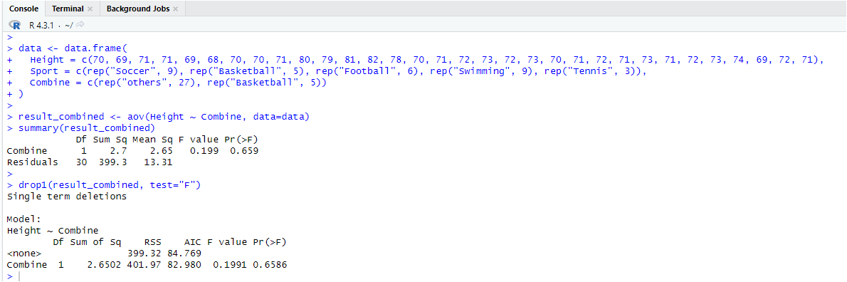
Height

Slide 9
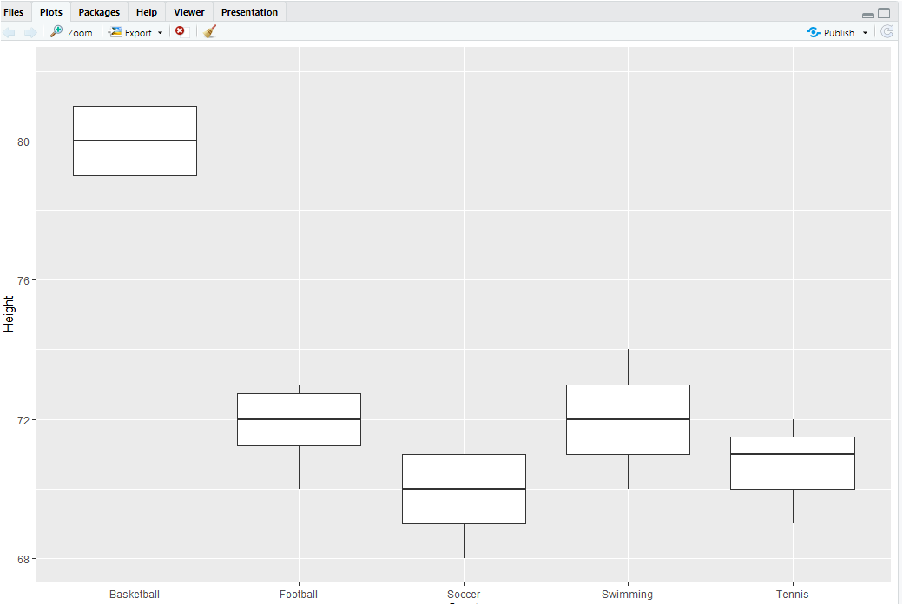
Height

Slide 10
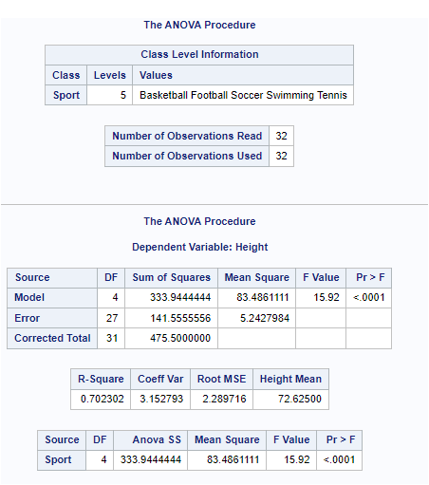
Height

Slide 11
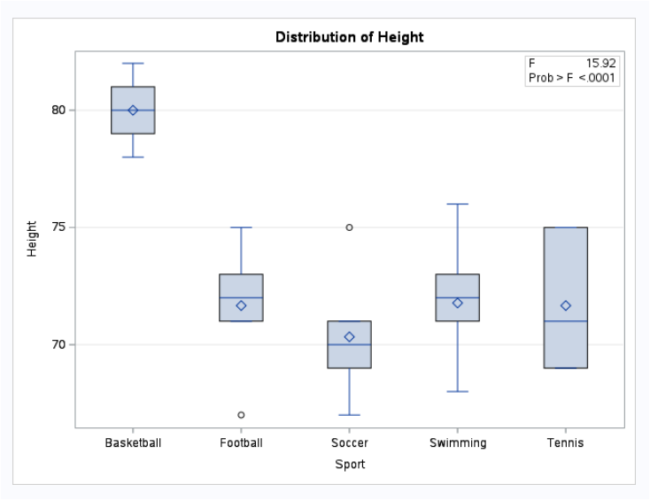
Height

Slide 12
End Question 2

Slide 13

Question 3 ($≤2$ hours)

Slide 14
HW Problem 1
Answer Question 25 on pg. 147 from the Statistical Sleuth. Follow the following guidelines while answering the question of interest.
Plot the raw data, and also plot the data after a log transform. After a log transform, do the data satisfy the assumptions better? The data is in ex0525.csv on Github. Perform this analysis in SAS.
Regardless of whether the assumptions of the original data or log transformed data are met, please include a complete analysis on the log transformed data.
State the Problem.
Address the assumptions. Comment on each assumption. (Use the visual test, as the Brown-Forsythe test will be overpowered due to the large sample size. This simply means that it is able to detect very small effect sizes—here, differences in standard deviations—which may not be big enough to practically affect the test.) Comment on your thoughts of the assumptions, but, in the end, assume there is not enough visual evidence to suggest the standard deviations of the log transformed data are different.
Conduct the Test. (An example is in the UNIT 5 PowerPoint.)
Write a conclusion. (An example is in the UNIT 5 PowerPoint.)
State the Scope. (Can we generalize to the entire population or just the sample that was taken? Is there a causal relationship present?)
ADDITIONAL THINGS TO INCLUDE (for the logged data):
Please also identify R²
Also specify the mean square error and how many degrees of freedom were used to estimate it.
Provide the code to perform the ANOVA in R and a screen shot of the output.

Slide 16
End Question 3

Slide 17
Question 4: Takeaways!
Please provide at least 4 takeaways from this section and any questions that you may have. These questions will help design the live session for this unit.
This question will be the last question of every For Live Session Assignment. The idea is that this deck will serve as a document that you can reference in the future to remember what was covered in this section. For instance, this may come in handy for the Capstone and will hopefully become useful in your career. Most immediately, it may become handy as a quick reference for your Midterm and Final! Some students find it very useful and spend a few slides summarizing the asynch material while others learn different ways and only had the minimum 4 takeaways. Either is fine and will earn you full credit for this question.

Slide 18
Question 5: Questions!
Please provide any question or topics of discussion that came up in this Unit! These will help help us optimize our live session for maximum learning and takeaways!
This question will be the last question of every For Live Session Assignment. The idea is that this deck will serve as a document that you can reference in the future to remember what was covered in this section. For instance, this may come in handy for the Capstone and will hopefully become useful in your career. Most immediately, it may become handy as a quick reference for your Midterm and Final! Some students find it very useful and spend a few slides summarizing the asynch material while others learn different ways and only had the minimum 4 takeaways. Either is fine and will earn you full credit for this question.

Slide 19
Useful Resources
www.itl.nist.gov/div898/handbook/prc/section4/prc433.htm

Slide 20
End For Live Session Assignment Unit 6!

